Slide 1
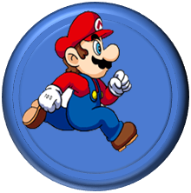
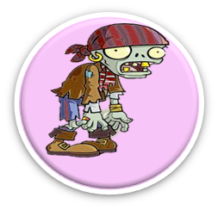
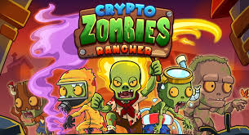
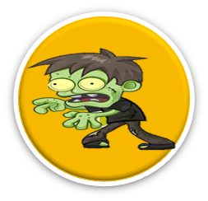
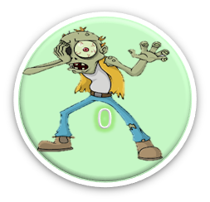

Game
Game
Game Decentralized Smart Contract
Paithoon

Slide 2
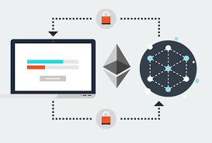
Solidity
Various program in writing in code but I choose in Solidity for programming. I manage it in Remix.ethereum.org.
Solidity

Slide 3

Smart Contract
I choose in Ethereum.io to transform byte code to Smart contract Code. It exists in platform with studying in contract which it cannot change in Solidity code; immutability. This exists in difficult on insider threat.
Smart
Contract

Slide 4
Ethereum
Various Ethereum platform prepares to being blockchain and decentralized system without central persons This business on marketing can cooperate with together any where and any time.
Ethereum

Slide 5
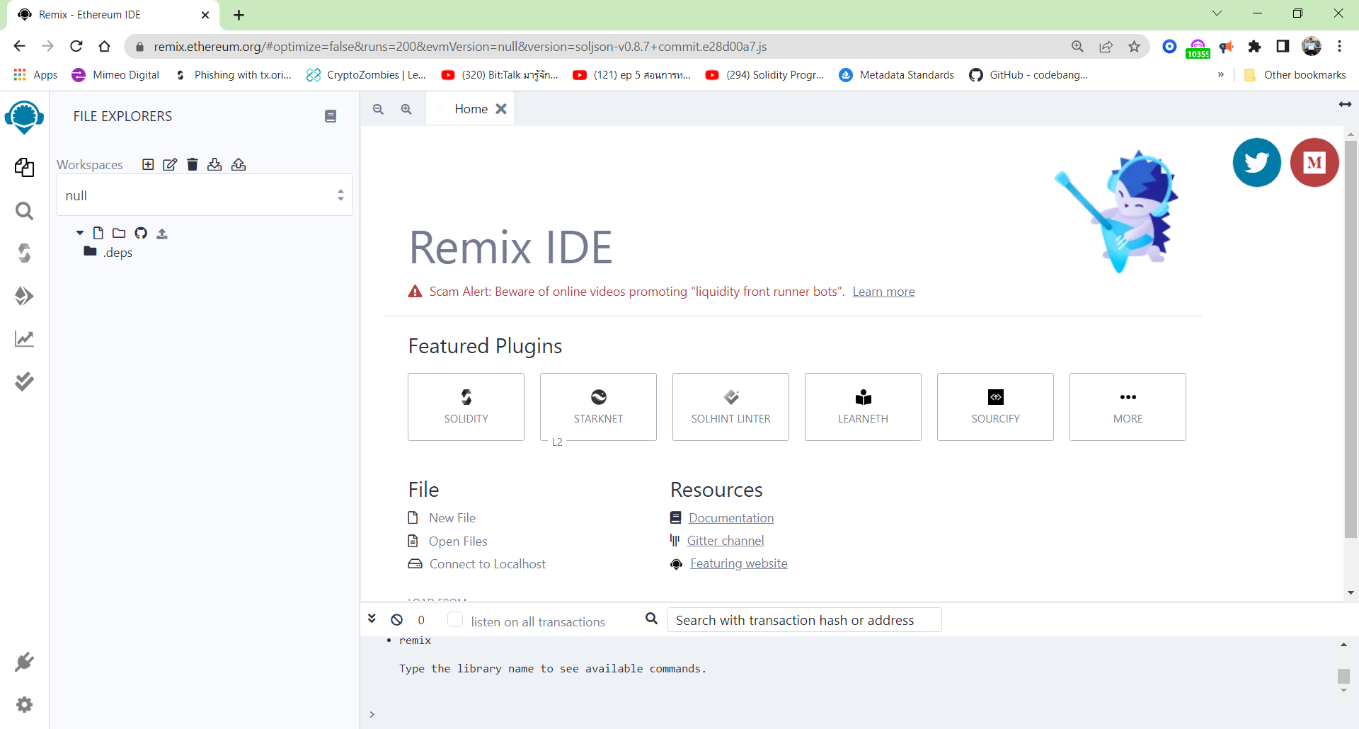
1. Remix
2. Press Solidity Platform

Slide 6
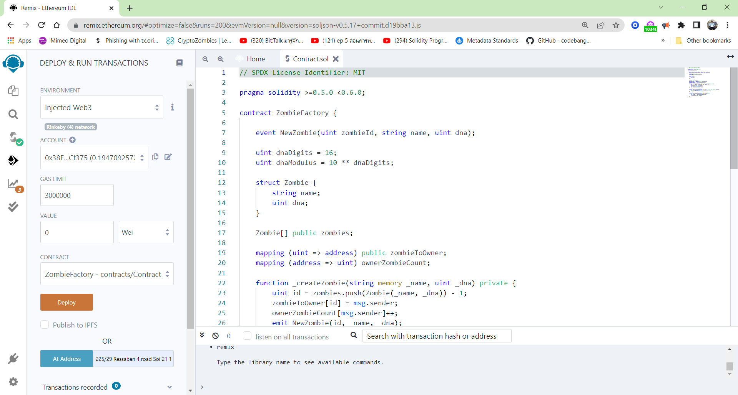
2. Change Inject Web3
3. Default after select Metamash Test net
Code
1. Press Deploy
4. Press Deploy Button
4. Select Address Home

Slide 7
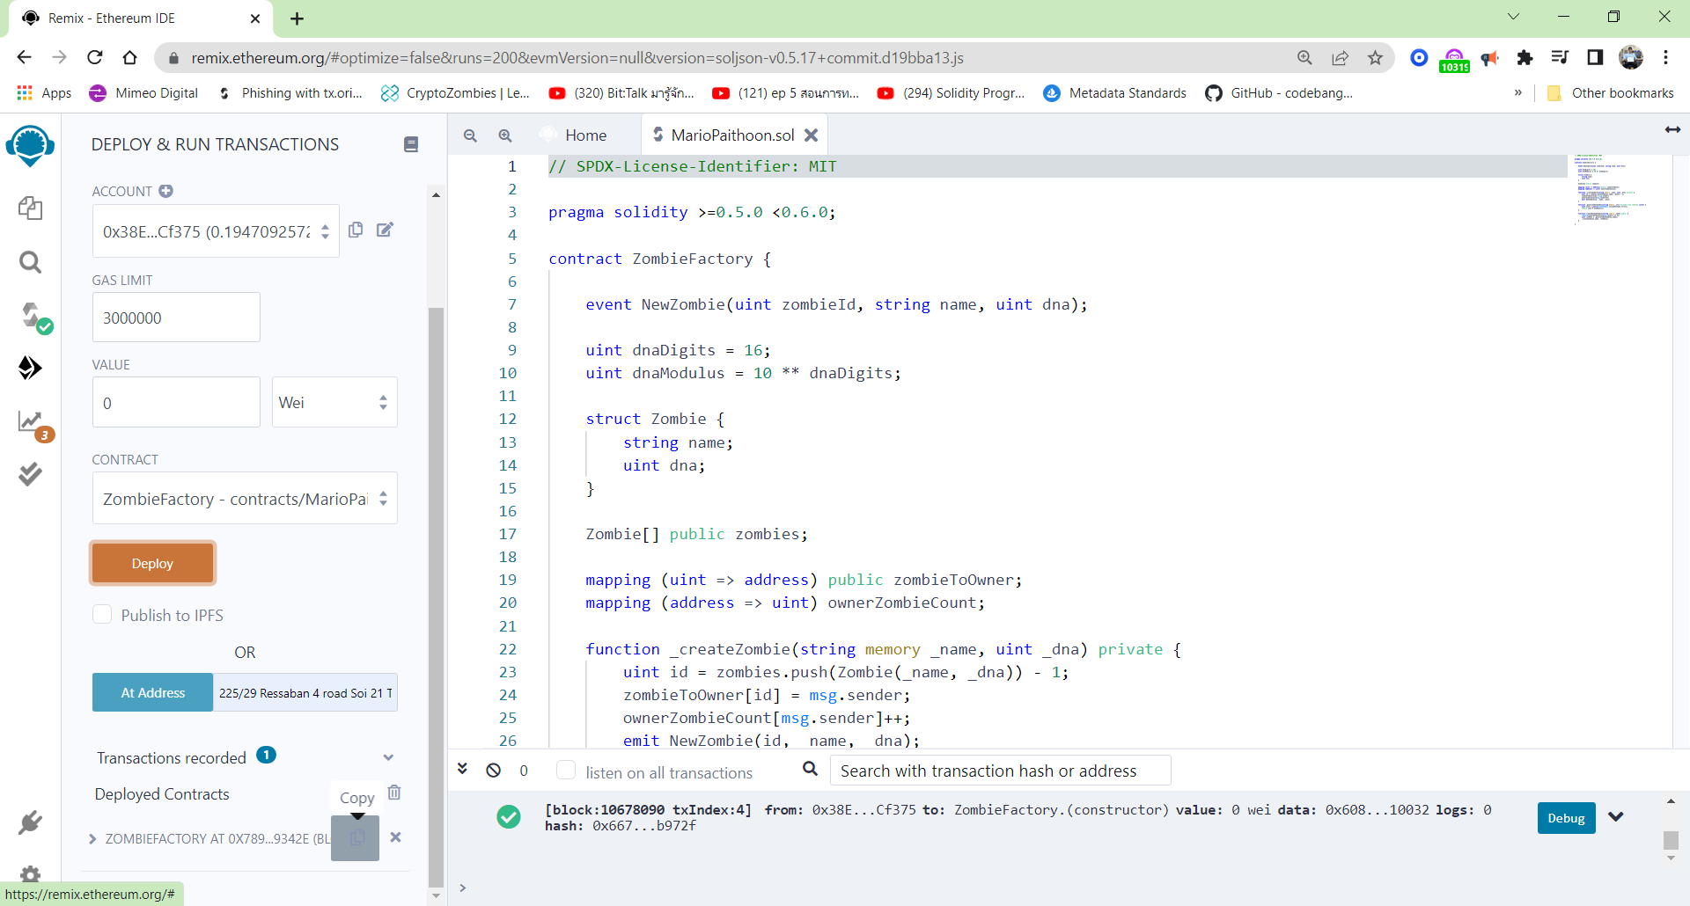
2. Press Copy to paste EstherScn.io
1. Byte Code after Press Deploy

Slide 8
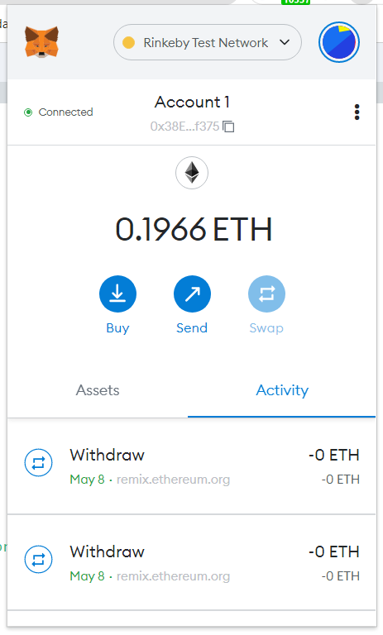
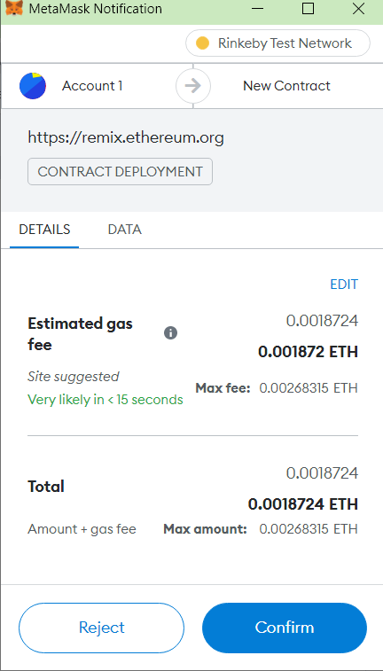
Select Test Network for Study
2. Byte Code do to Remix platform in Deploy
3. Press Confirm after press Deploy Button

Slide 9
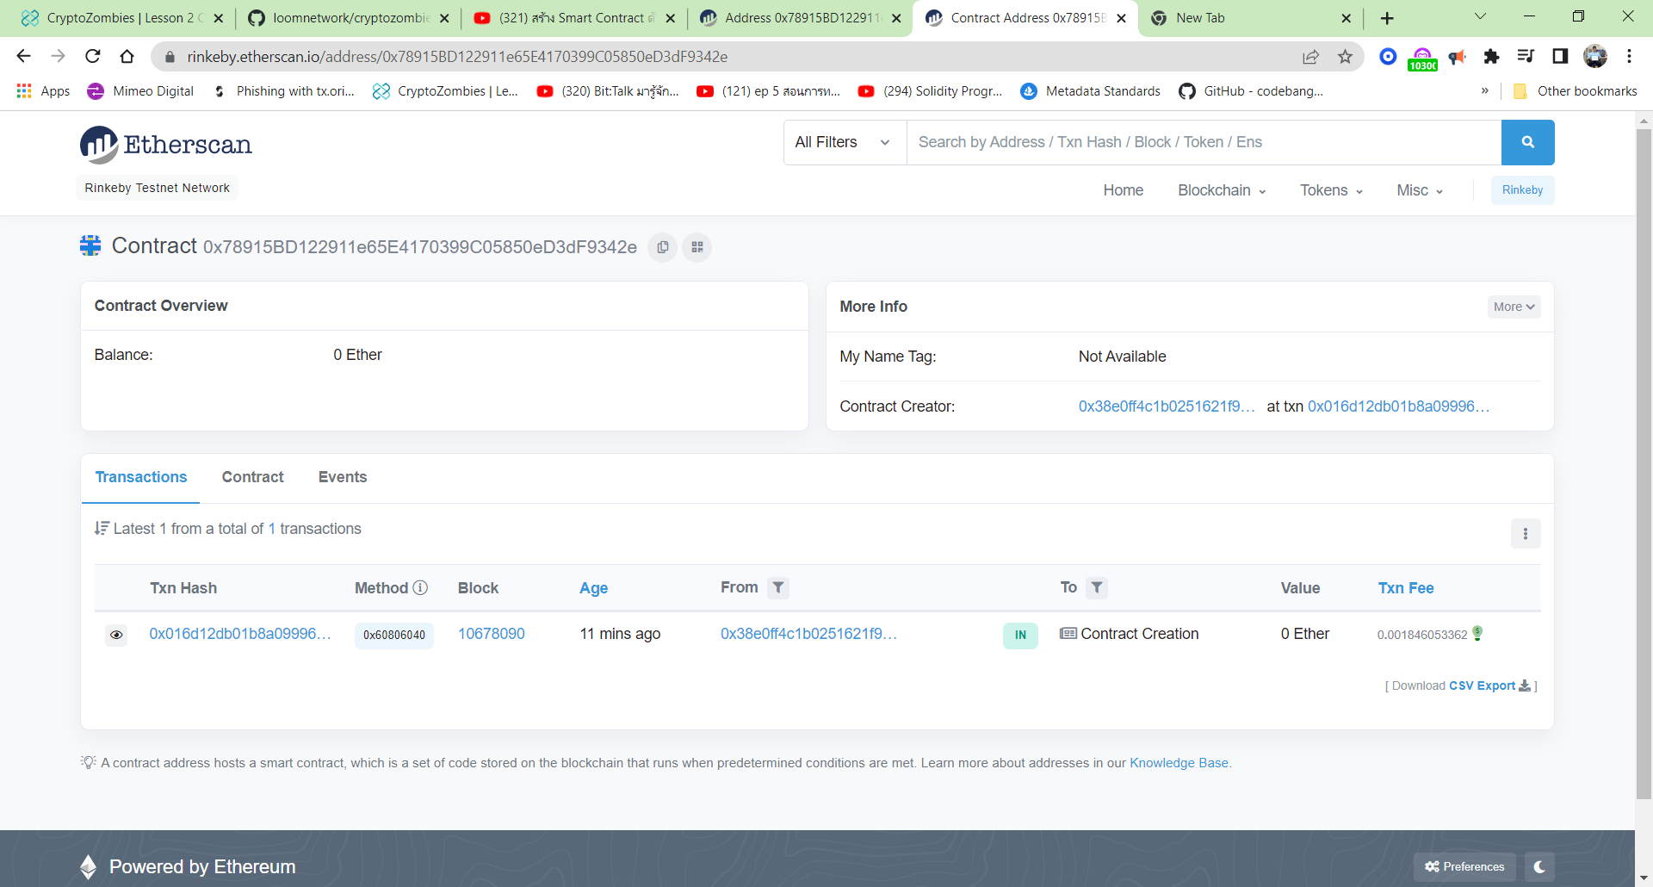
1. Select Test Network as same Metamask
2. Paste Byte Code for press Deploy button Complete

Slide 10
1. Click Contract

Slide 11
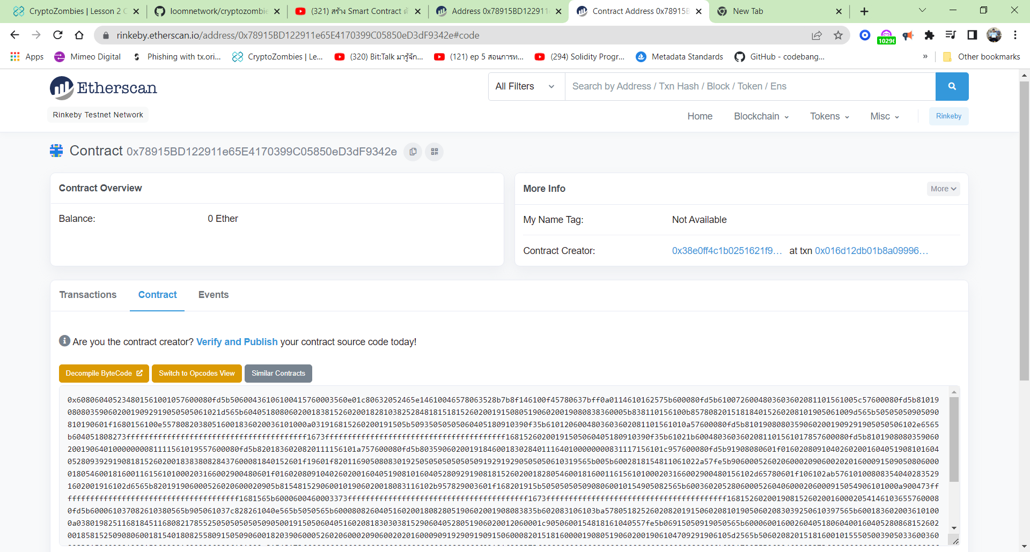
2. Click Verify and Public
1. Byte Code in Contract

Slide 12
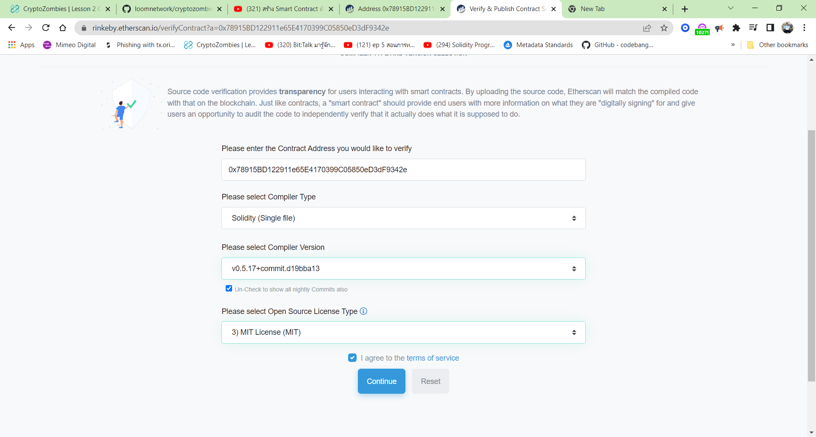
1. Select Solidity(single) File
2. Select Solidity Compile as same Remix platform
3. Select License as same Solidity Code
4. Press Continue Button

Slide 13
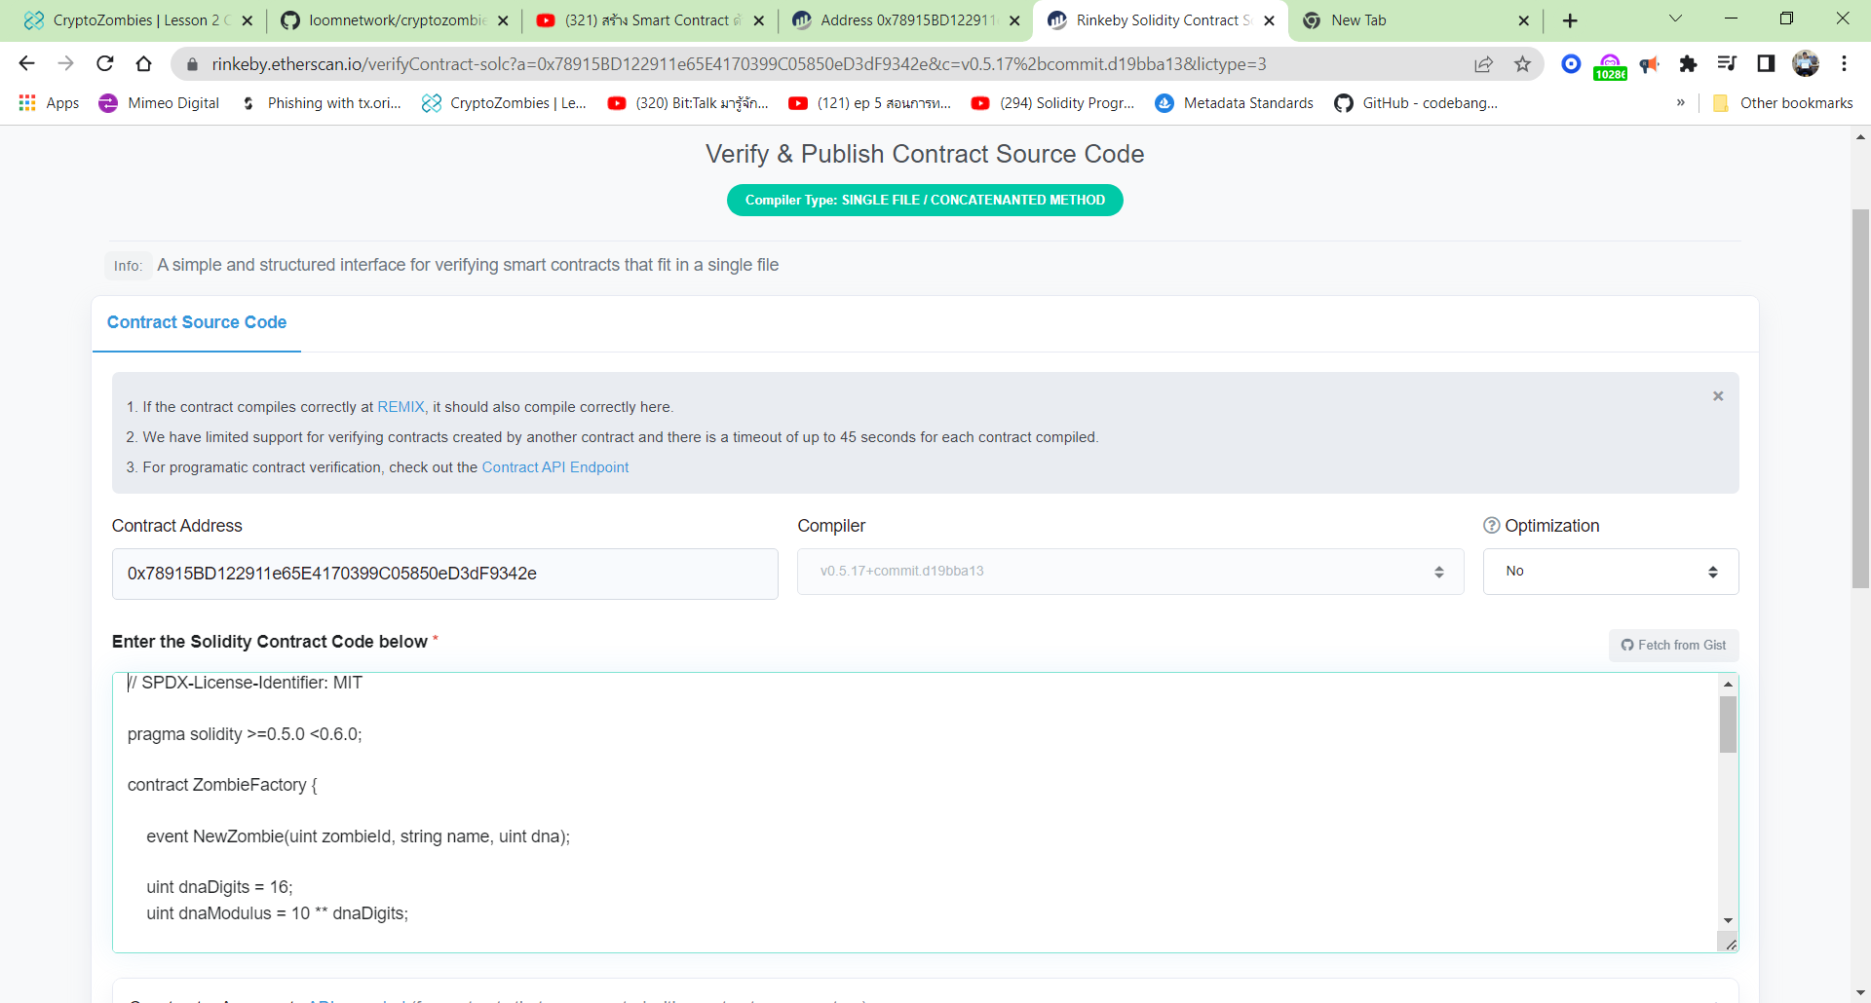
1. Copy Solidity Code to paste in this Location

Slide 14
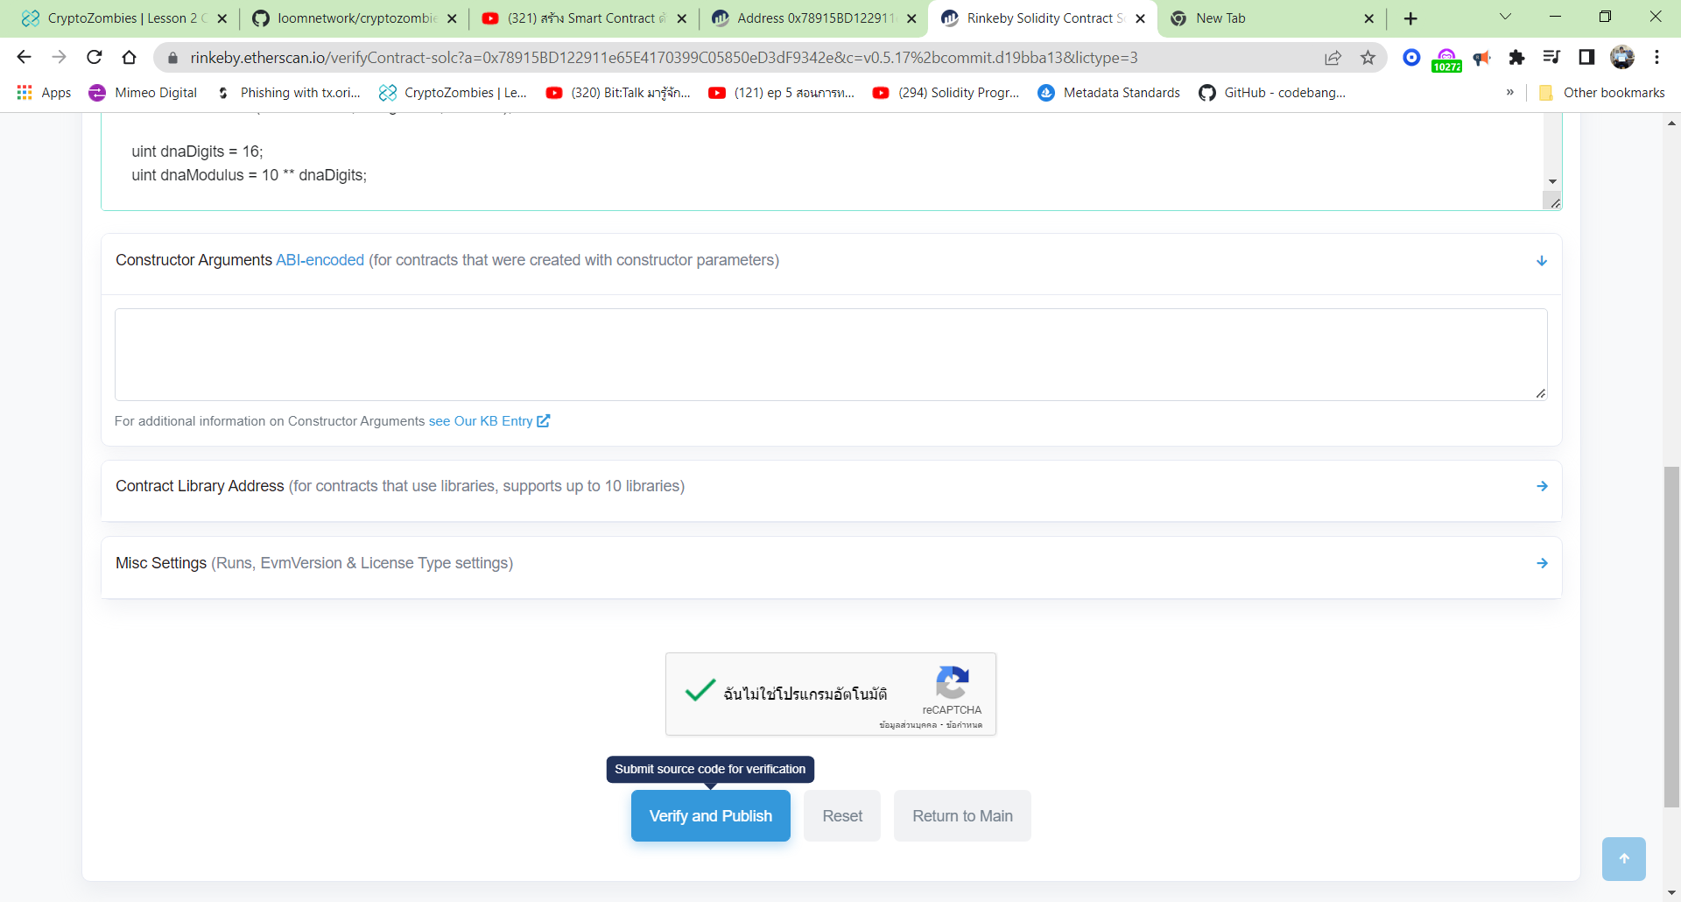
1. Click Mark
2. Press Verify and Public Button

Slide 15
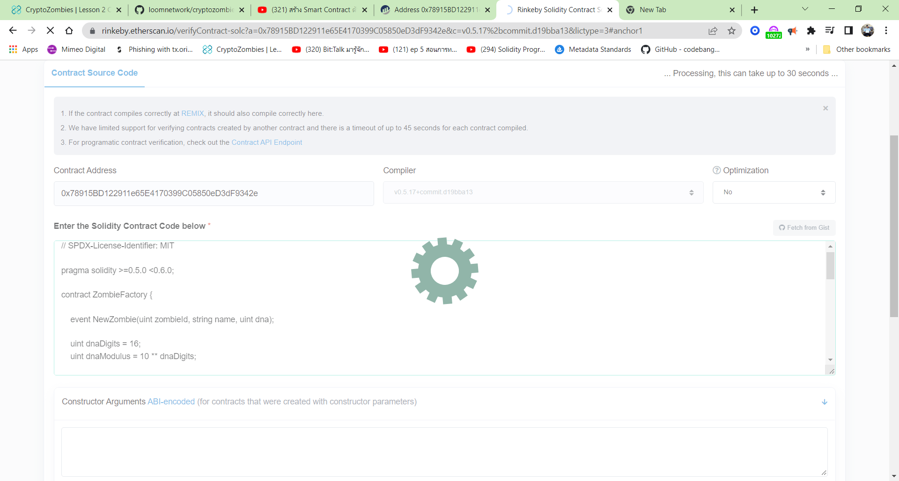
1. This Wheel occur

Slide 16
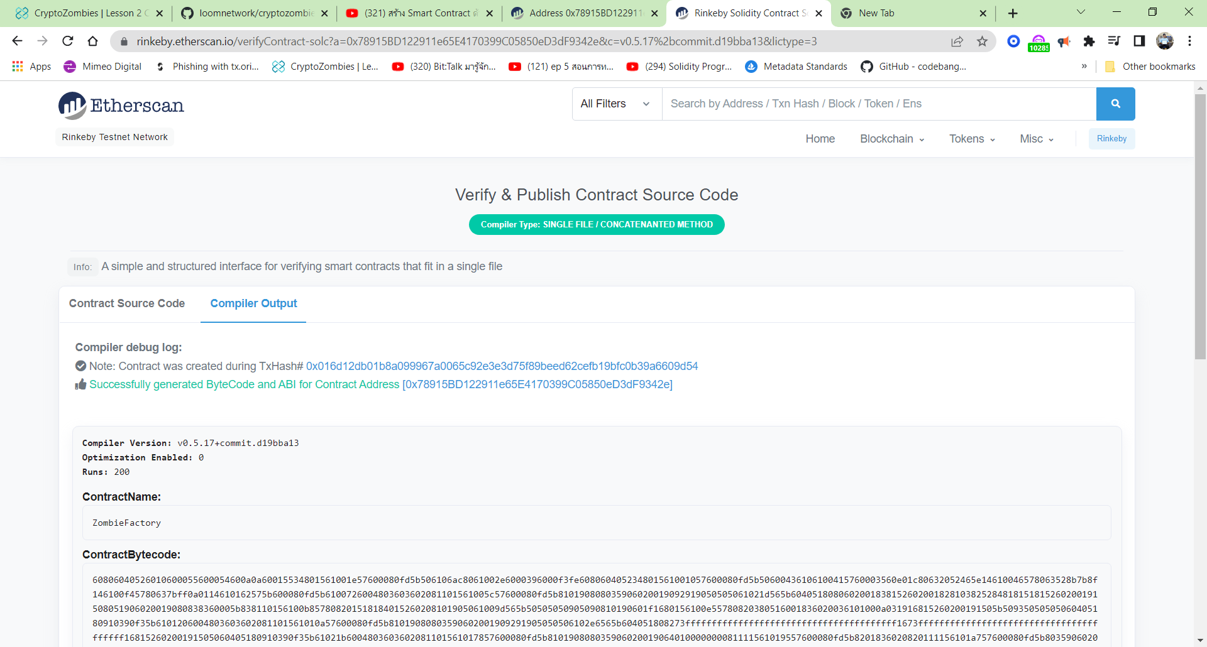
2.. Byte Code of Solidity File occur: Immutability
1. This Article occur to finish

Slide 17
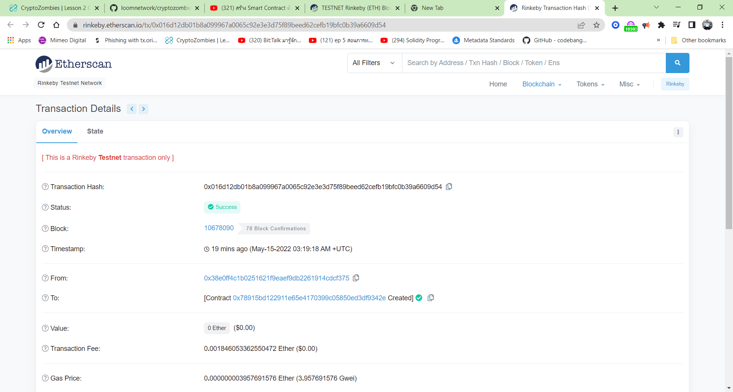
All Data of Contract from Smart Contract occur in Blockchain. Ethereum platform

Slide 18

The End
That right I thought hard and long. Could not this sample gambit of Joad’s be extended to include other aspects of the game to include all games? For me, it was the birth of gamesmanship.
Stephen Plotter, :Gamesmanship”

